Slide 1
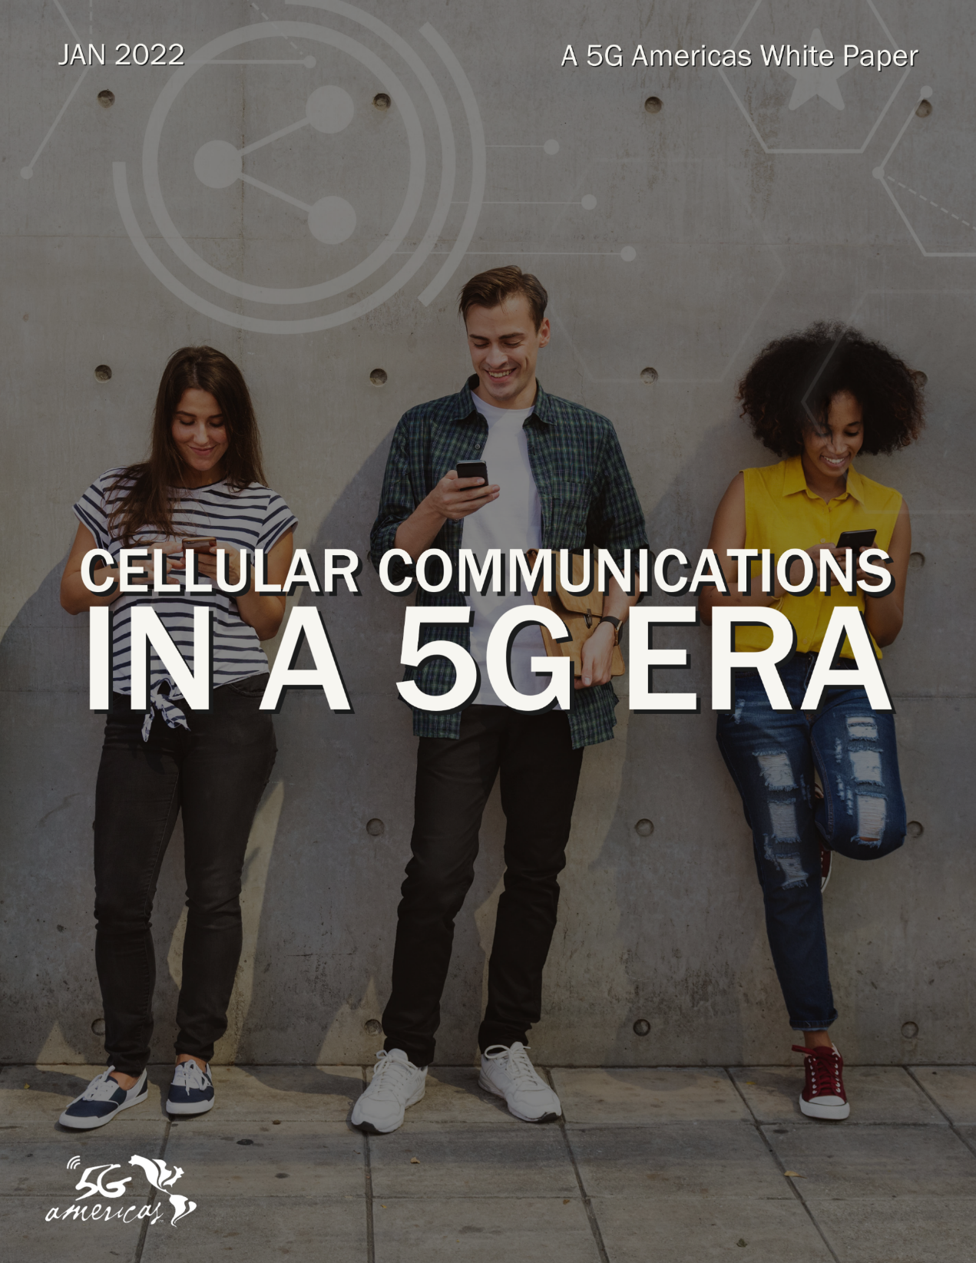
Presentation Slides Permission to use with attribution to ‘5G Americas’ is granted

Slide 2


“After three years of 5G network deployments, the industry is moving toward the enhancement phase of this generation of wireless cellular. These networks are beginning to change the technology landscape for new applications with their high data speeds and very low latencies.”
Chris Pearson, President, 5G Americas

Slide 3


“The sheer flexibility of 5G wireless cellular networks will continue to drive innovative use cases. More 5G capabilities will emerge as key enabling technologies and standardized 5G radio and core network architecture are developed, bringing about new use cases to many industry verticals.”
Brian Daly,
5G Americas working group leader and Assistant Vice President, Standards & Industry Alliances for AT&T

Slide 4
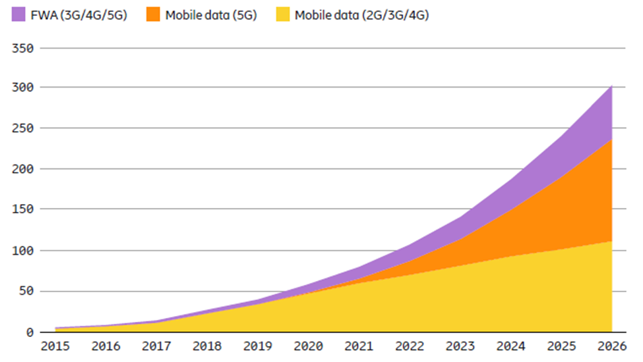
5G Deployment Models
Global Mobile Data Traffic (Exabytes/Month) 2015 to 2026

Slide 5
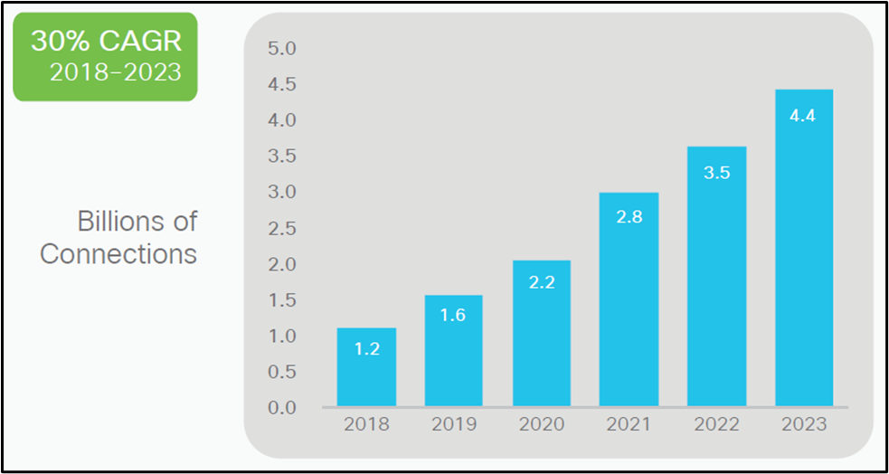

Global Mobile IoT (Billions)

Slide 6
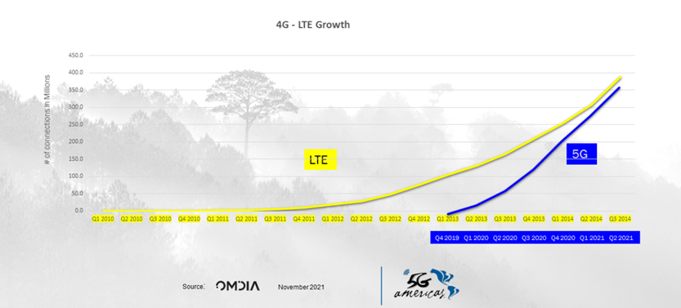
4G Growth Compared to 5G Growth – by Quarters

Slide 7
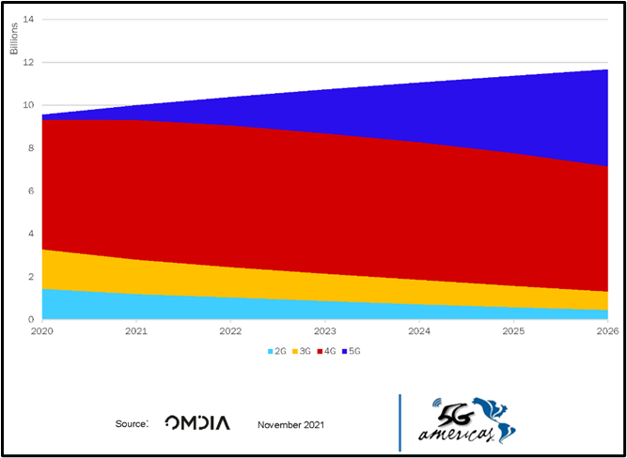
Mobile Subscriptions by Technology (Billions )

Slide 8
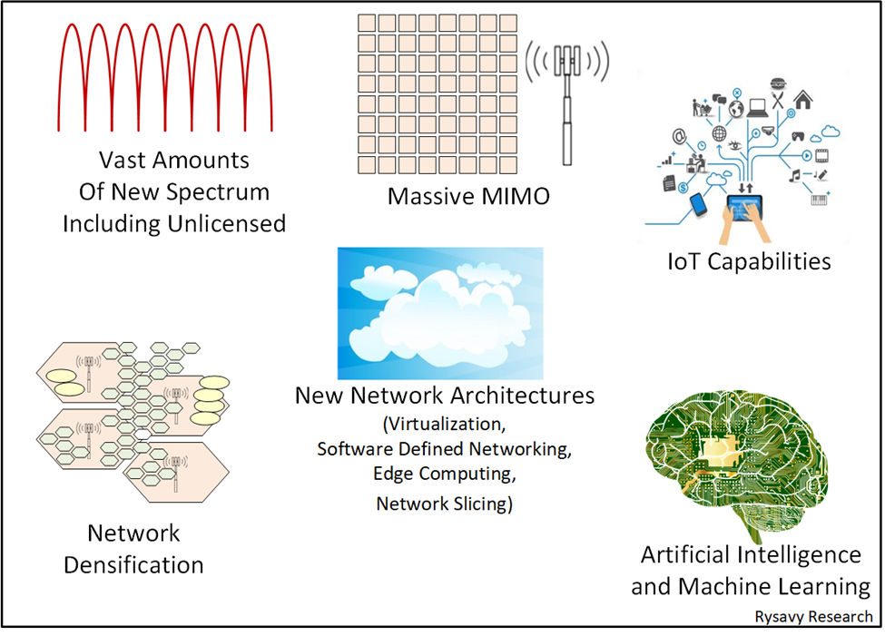

Fundamental Transformational Elements

Slide 9
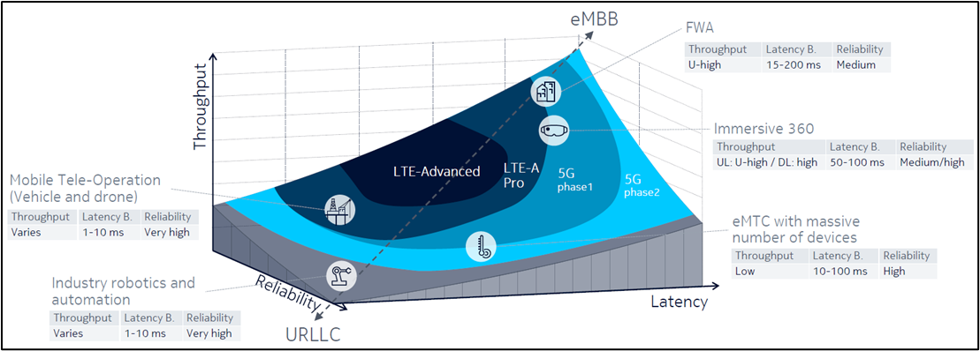
Requirements for Different 5G Use Cases

Slide 10
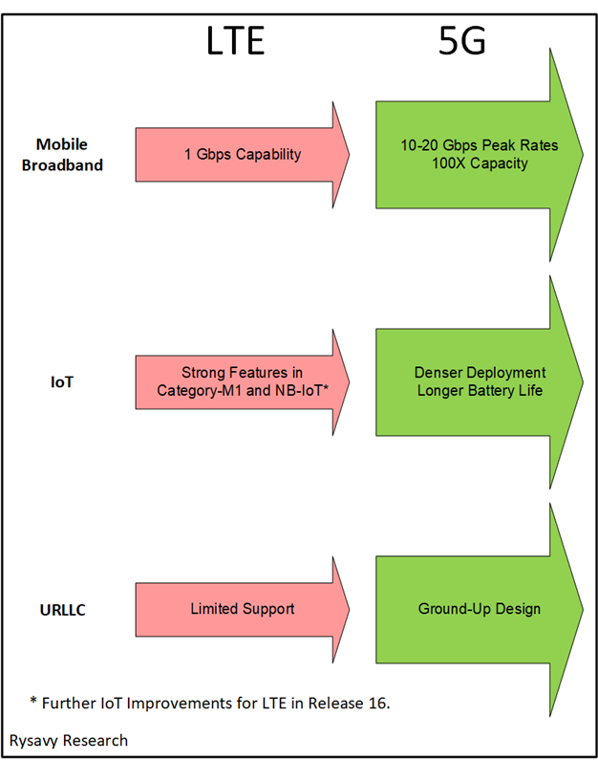

Comparison of Use Case Categories between LTE and 5G

Slide 11
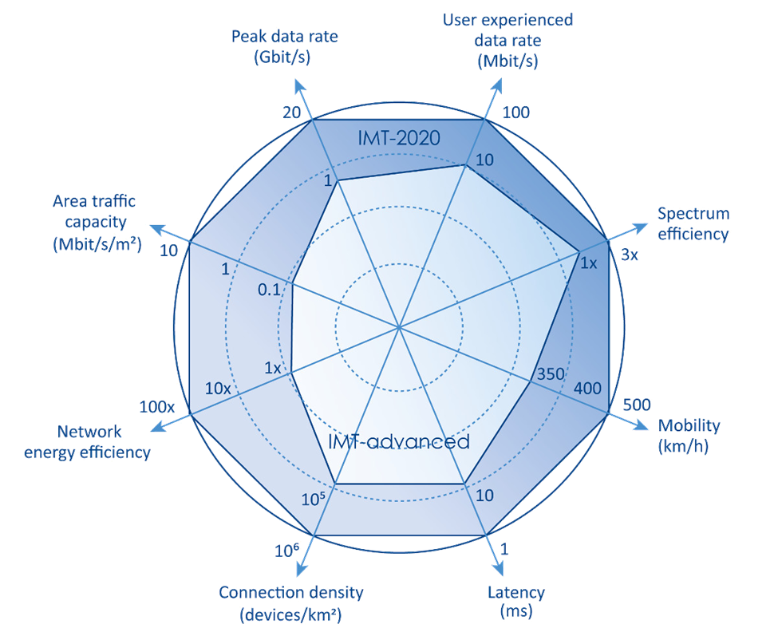
Comparison of Performance Characteristics between LTE and 5G

Slide 12
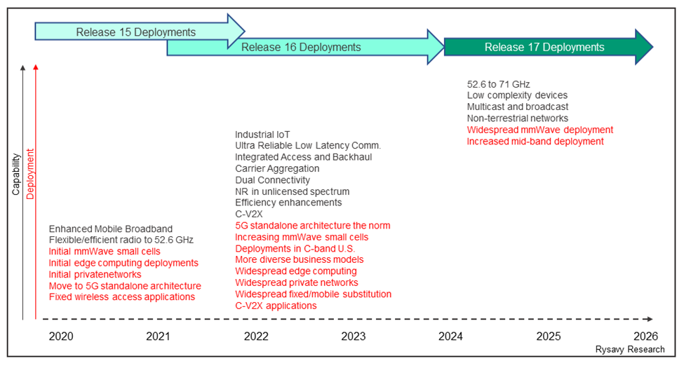

Key Capabilities and Deployment Over Time

Slide 13
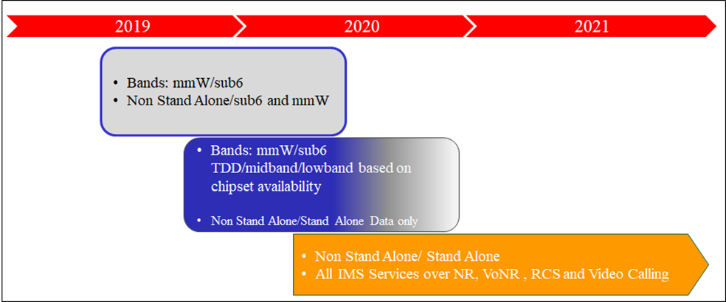

5G Device Timeline

Slide 14
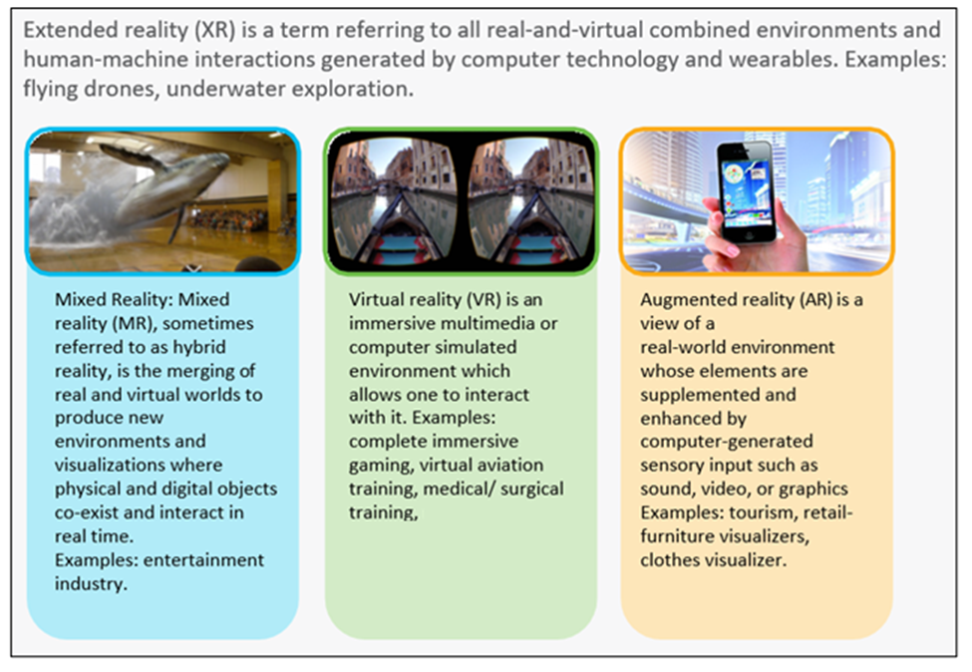
VR, AR, Mixed, and Extended

Slide 15
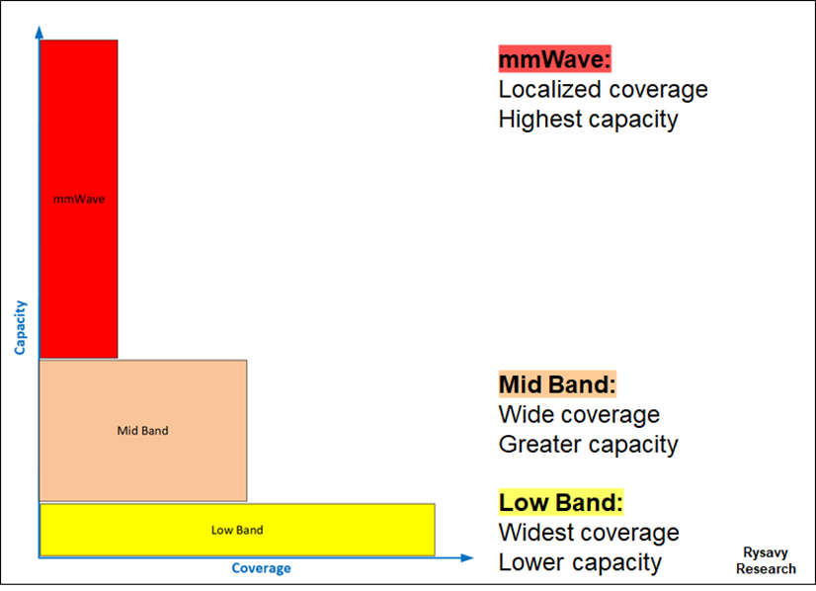

Three-Tier Spectrum Usage for 5G

Slide 16
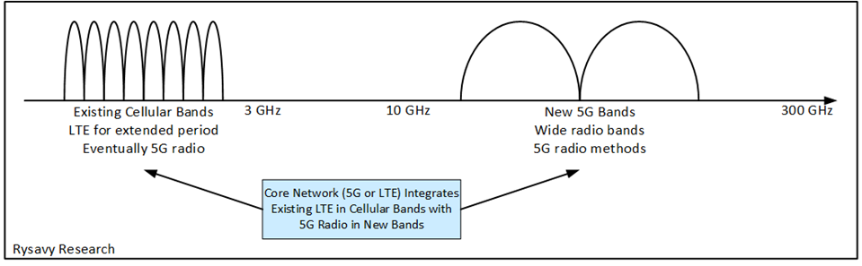
5G Combining of LTE and New Radio Technologies

Slide 17
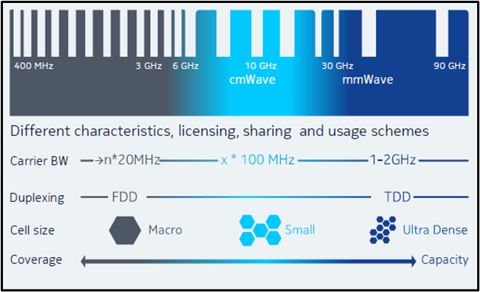
Characteristics of Different Bands

